Slide 1
Instructions (delete this slide)
Save this document with a new name before you begin work.
When adding a new slide, click on the small arrow next to “New Slide” on the toolbar. Select the layout that will best fit the content you want to add.
Change the layout of an existing slide: click the “Layout” button on the top toolbar to reformat your existing content to another master slide.
The dashed lines on the slide are guides. If you prefer to turn them off, go to the View menu, down to Guides and uncheck Guides.
Refer to utdallas.edu/brand for specific rules on using the University logos and wordmarks.
UTD_Light.pptx

Slide 2


Title Slide Example
Leave the title slide with an orange background or add a photo.
Click the icon in the center and select a photo from your hard drive, one that complements the purpose of your presentation.
TIP: Use University-approved photos from utdallas.tandemvault.com
Send the photo to the back (select picture, go to Picture Format>Send Backward>Send to Back).
Use Picture Format>Crop to adjust what part of the image is shown within the frame.
With the photo selected, go to Picture Format>Format Pane to open the image options. The far right icon contains Picture Color and Picture Transparency options.
Set the Transparency slider to 85%-90% to make white text legible.
Recolor the image to grayscale, using an option in the Recolor Presets dropdown menu.
This results in a subtle orange-washed image behind your title text, like the example below.
Author Name
Position title
Other information, such as School or Department
See Notes on the left
Delete this box
Notes:
Save this document with a new name before you begin work.
When adding a new slide, click on the small arrow next to “New Slide” on the toolbar. Select the layout that will best fit the content you want to add.
Change the layout of an existing slide: click the “Layout” button on the top toolbar to reformat your existing content to another master slide.
Refer to utdallas.edu/brand for specific rules on using the University logos and wordmarks.

Slide 3
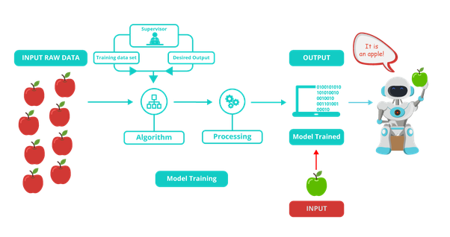
Offline Training model
Model Training
https://www.google.com/url?sa=i&url=https%3A%2F%2Fwww.i2tutorials.com%2Ftop-machine-learning-interview-questions-and-answers%2Fwhat-are-the-differences-between-supervised-machine-learning-and-unsupervised-machine-learning%2F&psig=AOvVaw0KlqTp--NpSnIaOLP1ykZ6&ust=1575837937456000&source=images&cd=vfe&ved=0CAIQjRxqFwoTCLjwwYO0pOYCFQAAAAAdAAAAABAj

Slide 4
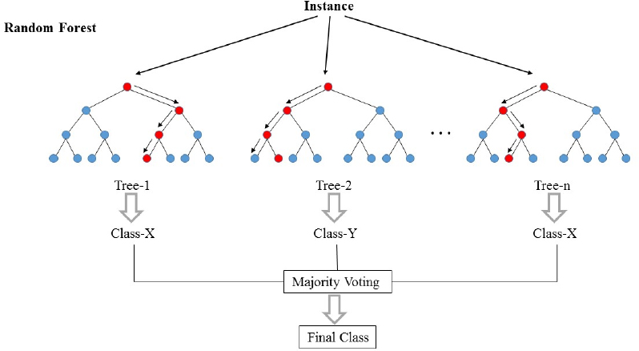
Random forest
Model Selection
In short, the random forest is several Decision Trees combined.
The samples are drawn with replacement, known as bootstrapping, which means that some samples will be used multiple times in a single tree.
Although each decision tree would have high variances, the overall forest low variance and at the same time keep low bias.
https://i.stack.imgur.com/iY55n.jpg

Slide 5
Preprocess
 | StringIndexer | RegexTokenizer | StopWordsRemover | HashingTF | Inverse Document Frequency (IDF)
Definition | Translate all the String classification to numeric | extracts tokens by matching the regex (Set Gap= False) | drops all the stop words from the input sequences | takes sets of terms and converts those sets into fixed-length feature vectors | rescale the feature vectors
Example | No:0,Crash:1,Fire:2,Shooting:3
Input | Crash | This is a text block where you can tab across and add copy | [take, route, 213, to, avoid, traffic, get, stuck, in, traffic, anyway, solution, drive, off, bridge, now, no, more, traffic, ever, again] | [take, route, 213, avoid, traffic, get, stuck, traffic, anyway, solution, drive, bridge, traffic, ever] | (200,[4,23,55,80,103,109,124,148,159,177,181,194],[3.0,1.0,1.0,1.0,1.0,1.0,1.0,1.0,1.0,1.0,1.0,1.0])
Output | 1 | [take, route, 213, to, avoid, traffic, get, stuck, in, traffic, anyway, solution, drive, off, bridge, now, no, more, traffic, ever, again] | [take, route, 213, avoid, traffic, get, stuck, traffic, anyway, solution, drive, bridge, traffic, ever] | (200,[4,23,55,80,103,109,124,148,159,177,181,194],[3.0,1.0,1.0,1.0,1.0,1.0,1.0,1.0,1.0,1.0,1.0,1.0]) | (200,[4,23,55,80,103,109,124,148,159,177,181,194],[7.1,3.2,2.7,3.1,2.7,3.3,3.2,2.6,2.5,3.2,3.2,3.0])
Footer information
Notes:
StringIndexer, RegexTokenizer, StopWordsRemover

Slide 6
We split the dataset to 70% for training and 30% For testing and come out with accuracy for evaluation.

Slide 7
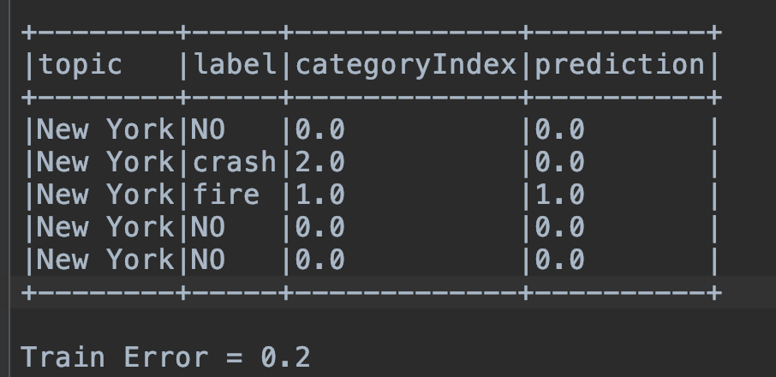
Streaming model accuracy
Structure
For each RDD,
We calculate accuracy and show the categoryIndex and the predictionIndex by DataFrame.
Footer information

Slide 8
We split the dataset to 70% for training and 30% For testing and come out with accuracy for evaluation.

Slide 9
Three-column layout
Structure
16-pt Header type
“Enter” and “Tab” 14-pt type
“Enter” and “Tab” 11-pt type
“Enter” “Tab” 11-pt type Bullets
“Enter” “Tab” 11-pt type 2nd Level Bullets
“Shift Tab” to move backwards through the options
Footer information

Slide 10
Table
Displaying data
Table header | Table header | Table header
This is a text block where you can tab across and add copy | This is a text block where you can tab across and add copy | This is a text block where you can tab across and add copy
This is a text block where you can tab across and add copy | This is a text block where you can tab across and add copy | This is a text block where you can tab across and add copy
This is a text block where you can tab across and add copy | This is a text block where you can tab across and add copy | This is a text block where you can tab across and add copy
This is a text block where you can tab across and add copy | This is a text block where you can tab across and add copy | This is a text block where you can tab across and add copy
Footer information

Slide 11
Column chart (single category)
Displaying data
Callout example
Callout example
Right-click the chart and select “Edit Data in Excel” to customize the values.
Footer information

Slide 12
Column chart (multi-category)
Displaying data
Callout example
Callout example
Right-click the chart and select “Edit Data in Excel” to customize the values.
Footer information

Slide 13
Stacked column chart
Displaying data
Callout example
Callout example
Right-click the chart and select “Edit Data in Excel” to customize the values.
Footer information

Slide 14
Bar chart
Displaying data
Callout example
Callout example
Right-click the chart and select “Edit Data in Excel” to customize the values.
Footer information

Slide 15
Line chart
Displaying data
Callout example
Callout example
Right-click the chart and select “Edit Data in Excel” to customize the values.
Footer information

Slide 16
Pie chart
Displaying data
Callout example
Callout example
Right-click the chart and select “Edit Data in Excel” to customize the values.
Footer information

Slide 17

“We are incredible at remembering pictures. Hear a piece of information, and three days later you’ll remember 10 percent of it. Add a picture and you’ll remember 65 percent.”
John Medina
Author of Brain Rules
Notes:
You can leave this background orange or add a subtle background photo using the directions from the title slide. Right-click on the image and select Change Picture to switch out the image.

Slide 18
“We are incredible at remembering pictures. Hear a piece of information, and three days later you’ll remember 10 percent of it. Add a picture and you’ll remember 65 percent.”
John Medina
Author of Brain Rules
Notes:
You can leave this background orange or add a subtle background photo using the directions from the title slide. Right-click on the image and select Change Picture to switch out the image.

Slide 19
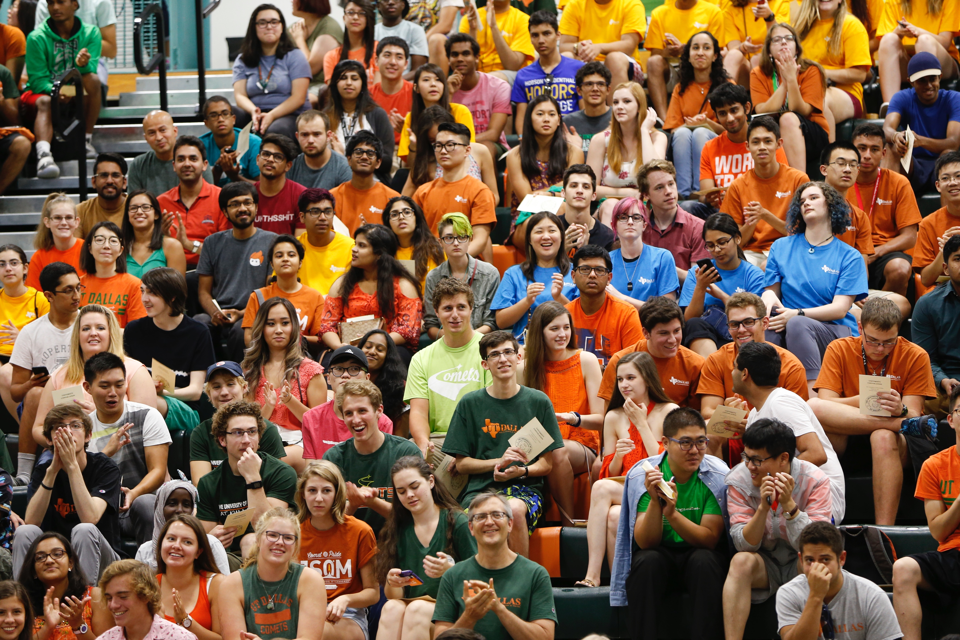

UT Dallas Enrollment
Our student body has seen a 163% increase in 9 years.
Footer information
Notes:
Example Slide – 3 columns

Slide 20
UT Dallas Enrollment
Upward Trajectory: example slide
Our student body has seen a 163% increase in 9 years
Footer information
Notes:
Example Slide – 2 columns

Slide 21
Quote slide style example layout. Text should be sentence case.
First, Last Name
Company name
Title comes here
Notes:
Quote slide without photo background

Slide 22
Callout style examples
Text Here
Text Here
Text Here
Text Here
Text Here
Text Here
Text Here
Text Here
Footer information
Notes:
Copy and paste these onto various slides to highlight main points

Slide 23








UT Dallas Marks

Slide 24
Section head
Overview of the section
Use to segue to another section
Use as a Q&A slide

Slide 25

Thank you
Contact information or summary
More details concerning the brand standards for UT Dallas can be found online at utdallas.edu/brand.

